Slide 1
Our Library and How to Use It
Emma Craig Regional Librarian A.C. Hunter Public Library

Slide 2
Agenda
Background
Getting a Library Card
Resources at the Library
Resources Online
Programs
Supporting the Library

Slide 3
Background
A little information about myself and our library system

Slide 4
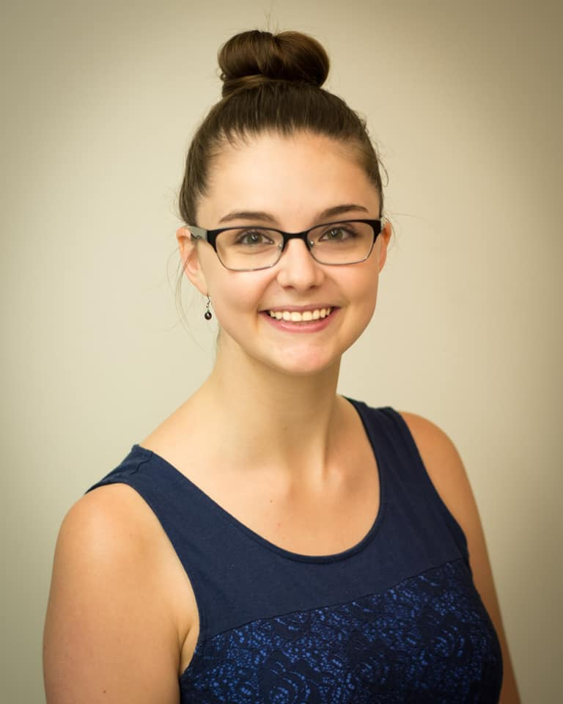
About Me
Originally from Ontario
Master’s Degree in Library and Information Science from Dalhousie University
Interests include reading, video games, movies, and true crime
My favourite genres to read and watch are fantasy and science fiction
Regional Librarian for St. John’s area
Help out the branches
Create new programs and services
Go out to community to talk about the library

Slide 5
About Newfoundland & Labrador Public Libraries
94 branches across Newfoundland & Labrador
Can request anything from across the province through ILL

Slide 6
About A.C. Hunter Library
Located in the Arts & Culture Centre
Biggest branch in NLPL
Also serves as the Provincial Resource Library
https://bit.ly/315Peim

Slide 7
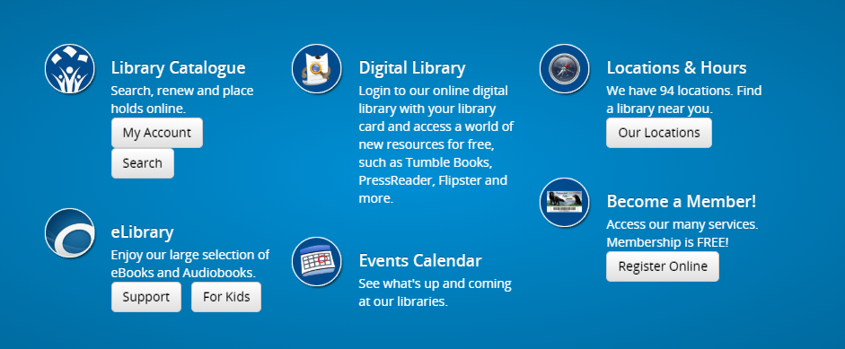
Getting a Library Card – Our Process is Easy!
Obtaining a Library Card at a Library Branch
Bring one piece of identification that contains a unique number and documentation showing your current home address
Those under 13 years of age need a parent or guardian to sign the registration form
Registering Online for a Library Card
Follow the button on our website to the online form
Card will be mailed to your address

Slide 8
Resources at the Library
Physical resources and services offered at our branch

Slide 9
Resources at the Library
BOOKS!
Fiction, non-fiction, magazines, graphic novels, etc.
DVDs and CDs
Video games (yes really)
All materials can typically be taken out for 3 weeks
Unless it is in high demand, then 2 weeks
Can search for materials through the online catalogue
https://bit.ly/3kJv1H9

Slide 10
Newfoundland & Labrador Collection
Books, periodicals, newspapers, government documents, maps, photographs, post cards, pamphlets and manuscripts all related to Newfoundland & Labrador
Materials dating from 1630 to the present
Reference and research assistance
In-Library use of materials
Microfilm readers, microfilm reader-printer, and photocopier
Computers with scanner, internet access, laser and colour printers
Access to items in online catalogue

Slide 11
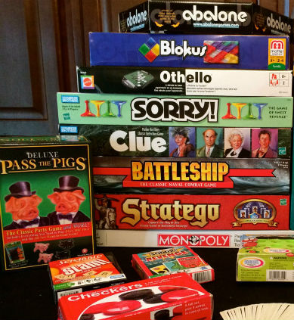
Board Game Collection
300 board games, thanks to a generous donation from TimeMaster’s Inc.
Just as easy as lending out a book!
Max. loan period of 3 weeks
https://bit.ly/3iFMBtF

Slide 12
Sun Life Financial Musical Lending Library
A collection of instruments that you may borrow using your NLPL Public Library card
Full list of instruments on NLPL website
Borrowing period of 4 weeks
Responsible for maintaining and returning instruments in good condition
We do accept donations of instruments
https://nlpl.ca/programs/musiclibrary/instrument-collection.html

Slide 13
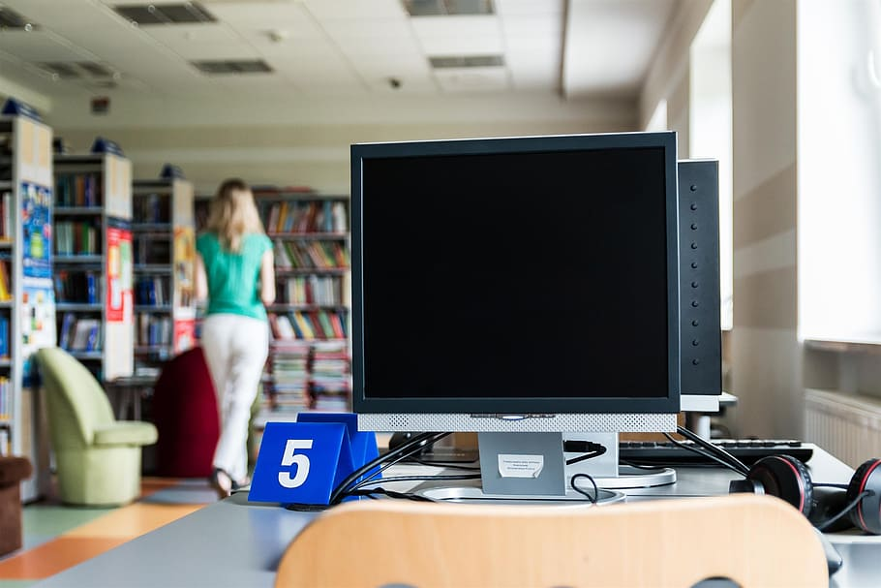
Computers and Internet
Free access to public access computer terminals
Sign in with library card
Can book a computer in advance http://booking.nlpl.ca/Cire/login.aspx
Printing Services
Document and Photo Scanners
https://bit.ly/3hhMsfX

Slide 14
Multilingual Library Resources
A result of The Welcome Project, a community consultation project aimed at making our libraries more welcoming for newcomers

Slide 19
Accessible Library Services
Audiobooks collection
eBooks and Audiobooks in Digital Library (more about that later)
Large print books
Signed Stories in Digital Library
Video Descriptive and Closed Captions videos

Slide 20
Centre for Equitable Library Access (CELA)
CELA Collection
For people who have difficulty reading print due to a visual, physical, or learning disability
Accessible books and magazines
Audio, Braille, and accessible eBooks
Accessible online services for web reading and research
Patrons can either self-register using CELA’s online registration form or contact Technical Services
https://bit.ly/322f8CS

Slide 21
Online Resources
Virtual resources and services offered at our branch

Slide 22
Digital Library
eBooks & eAudiobooks
Including Tumblebooks
eNewspapers & eMagazines
eLibrary Guides & Support: https://elibrarysupport.nlpl.ca/
https://digitallibrary.nlpl.ca/

Slide 23
NLPL Youtube
In-depth tutorials on library services and resources
NL history content
Children’s programming at home
Story Times
Felts and rhymes
https://www.youtube.com/channel/UCW2iZS0sJlH67js0AFe9gaA

Slide 24
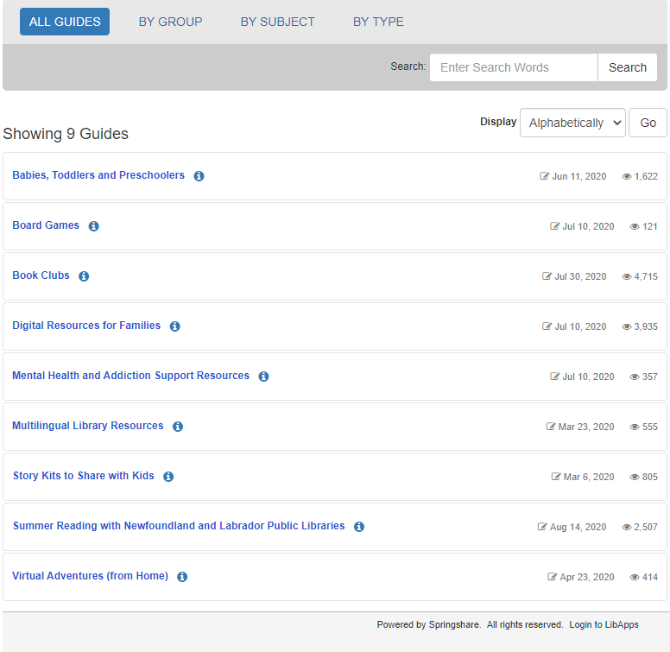
LibGuides
Guides on library programs and services
Themed ones featuring library materials and resources
https://guides.nlpl.ca/

Slide 25
Programs at the Library
Programs offered at our branch

Slide 26
Story Times
Storytimes are a great way for kids (and parents) to practice English language skills
Available for children ages 3-5
30-60 minutes in length
Includes rhymes, stories, counting, singing, plays and puppets, dancing and social time
Virtual Story Times available on the NLPL website
https://bit.ly/3aJsI2l

Slide 27
Information Sessions
Previous sessions
Taxes and Money Management
Computer Basics and Internet Safety
Stop Smoking
Gardening
English Conversation Circles
We are happy to host one with your organization
Don't see a session that interests you?
Recommendations are welcome!
https://bit.ly/3iUEvh7

Slide 28
Book Clubs
Book Club Kits
10 copies of one book
Discussion questions and info about the author
Loan period of 6 weeks
Resources for Digital Book Clubs
Selection of eBooks and eAudiobooks with unlimited user access
Book Clubs LibGuide with resources and booklists
https://bit.ly/3g6A9Bo
https://guides.nlpl.ca/bookclubs

Slide 29
TD Summer Reading Club
Canada’s largest bilingual reading program
Encourage kids to read for pleasure over the course of the summer and keep their literacy skills fresh
NLPL libraries run a variety of programming related to the theme of the TDSRC each year
https://bit.ly/3kRHAQL

Slide 30
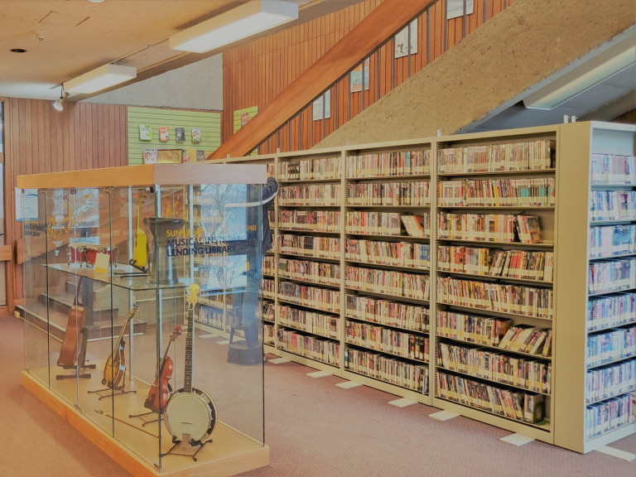
Library Tours
Available by appointment for any size of group, class, club or organization
Learn about local library staff, collections, services, and resources during your tour
If you arrange ahead of time, we can sign participants up for free library cards and give them their new card at the end of the tour
Work with your group for translation purposes
Tours can also include a short story time or assistance with research if requested
https://bit.ly/2DUxf62

Slide 31
Supporting the Library
The little things you can do to make our branch better!

Slide 32
Supporting the Library
Sign-up for a library card
Become a volunteer
Make a donation
Library materials
Donations of money
https://bit.ly/347NUNT

Slide 33
Expanding our Newcomer Services
If you have ideas for programs and would like to explore a partnership with the libraries in the St. John's area, please contact us!
Susan Prior - 709-737-3418 or sprior@nlpl.ca
Emma Craig – 709-737-3432 or ecraig@nlpl.ca

Slide 34
Thank you for listening!
I can answer any questions you may have today or you can contact me anytime!
Email: ecraig@nlpl.ca
Phone: (709) 737-3432
https://bit.ly/2Q2rzt1

